Slide 1

RetailInsight 360
Transforming Fragmented Data into Strategic Intelligence
An end-to-end analytics pipeline that bridges the gap between raw retail data and actionable customer engagement, enabling real-time business optimization across stores, inventory, and loyalty programs.

Slide 2
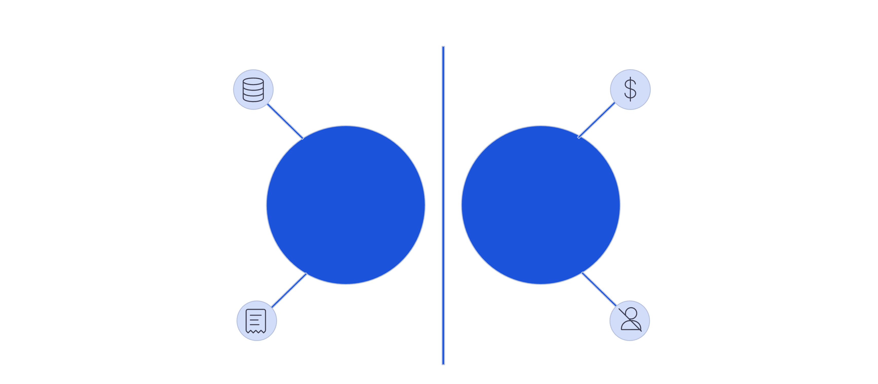




The Business Challenge
High-volume data, quality issues
Missed revenue opportunities
Current State Challenges
RetailInsight 360 Solutions
Fragmented transaction records
Disconnected customer touchpoints
RetailInsight 360 establishes a comprehensive data lifecycle from ingestion to strategic action, transforming how retailers protect revenue, reward loyalty, and optimize operations.

Slide 3
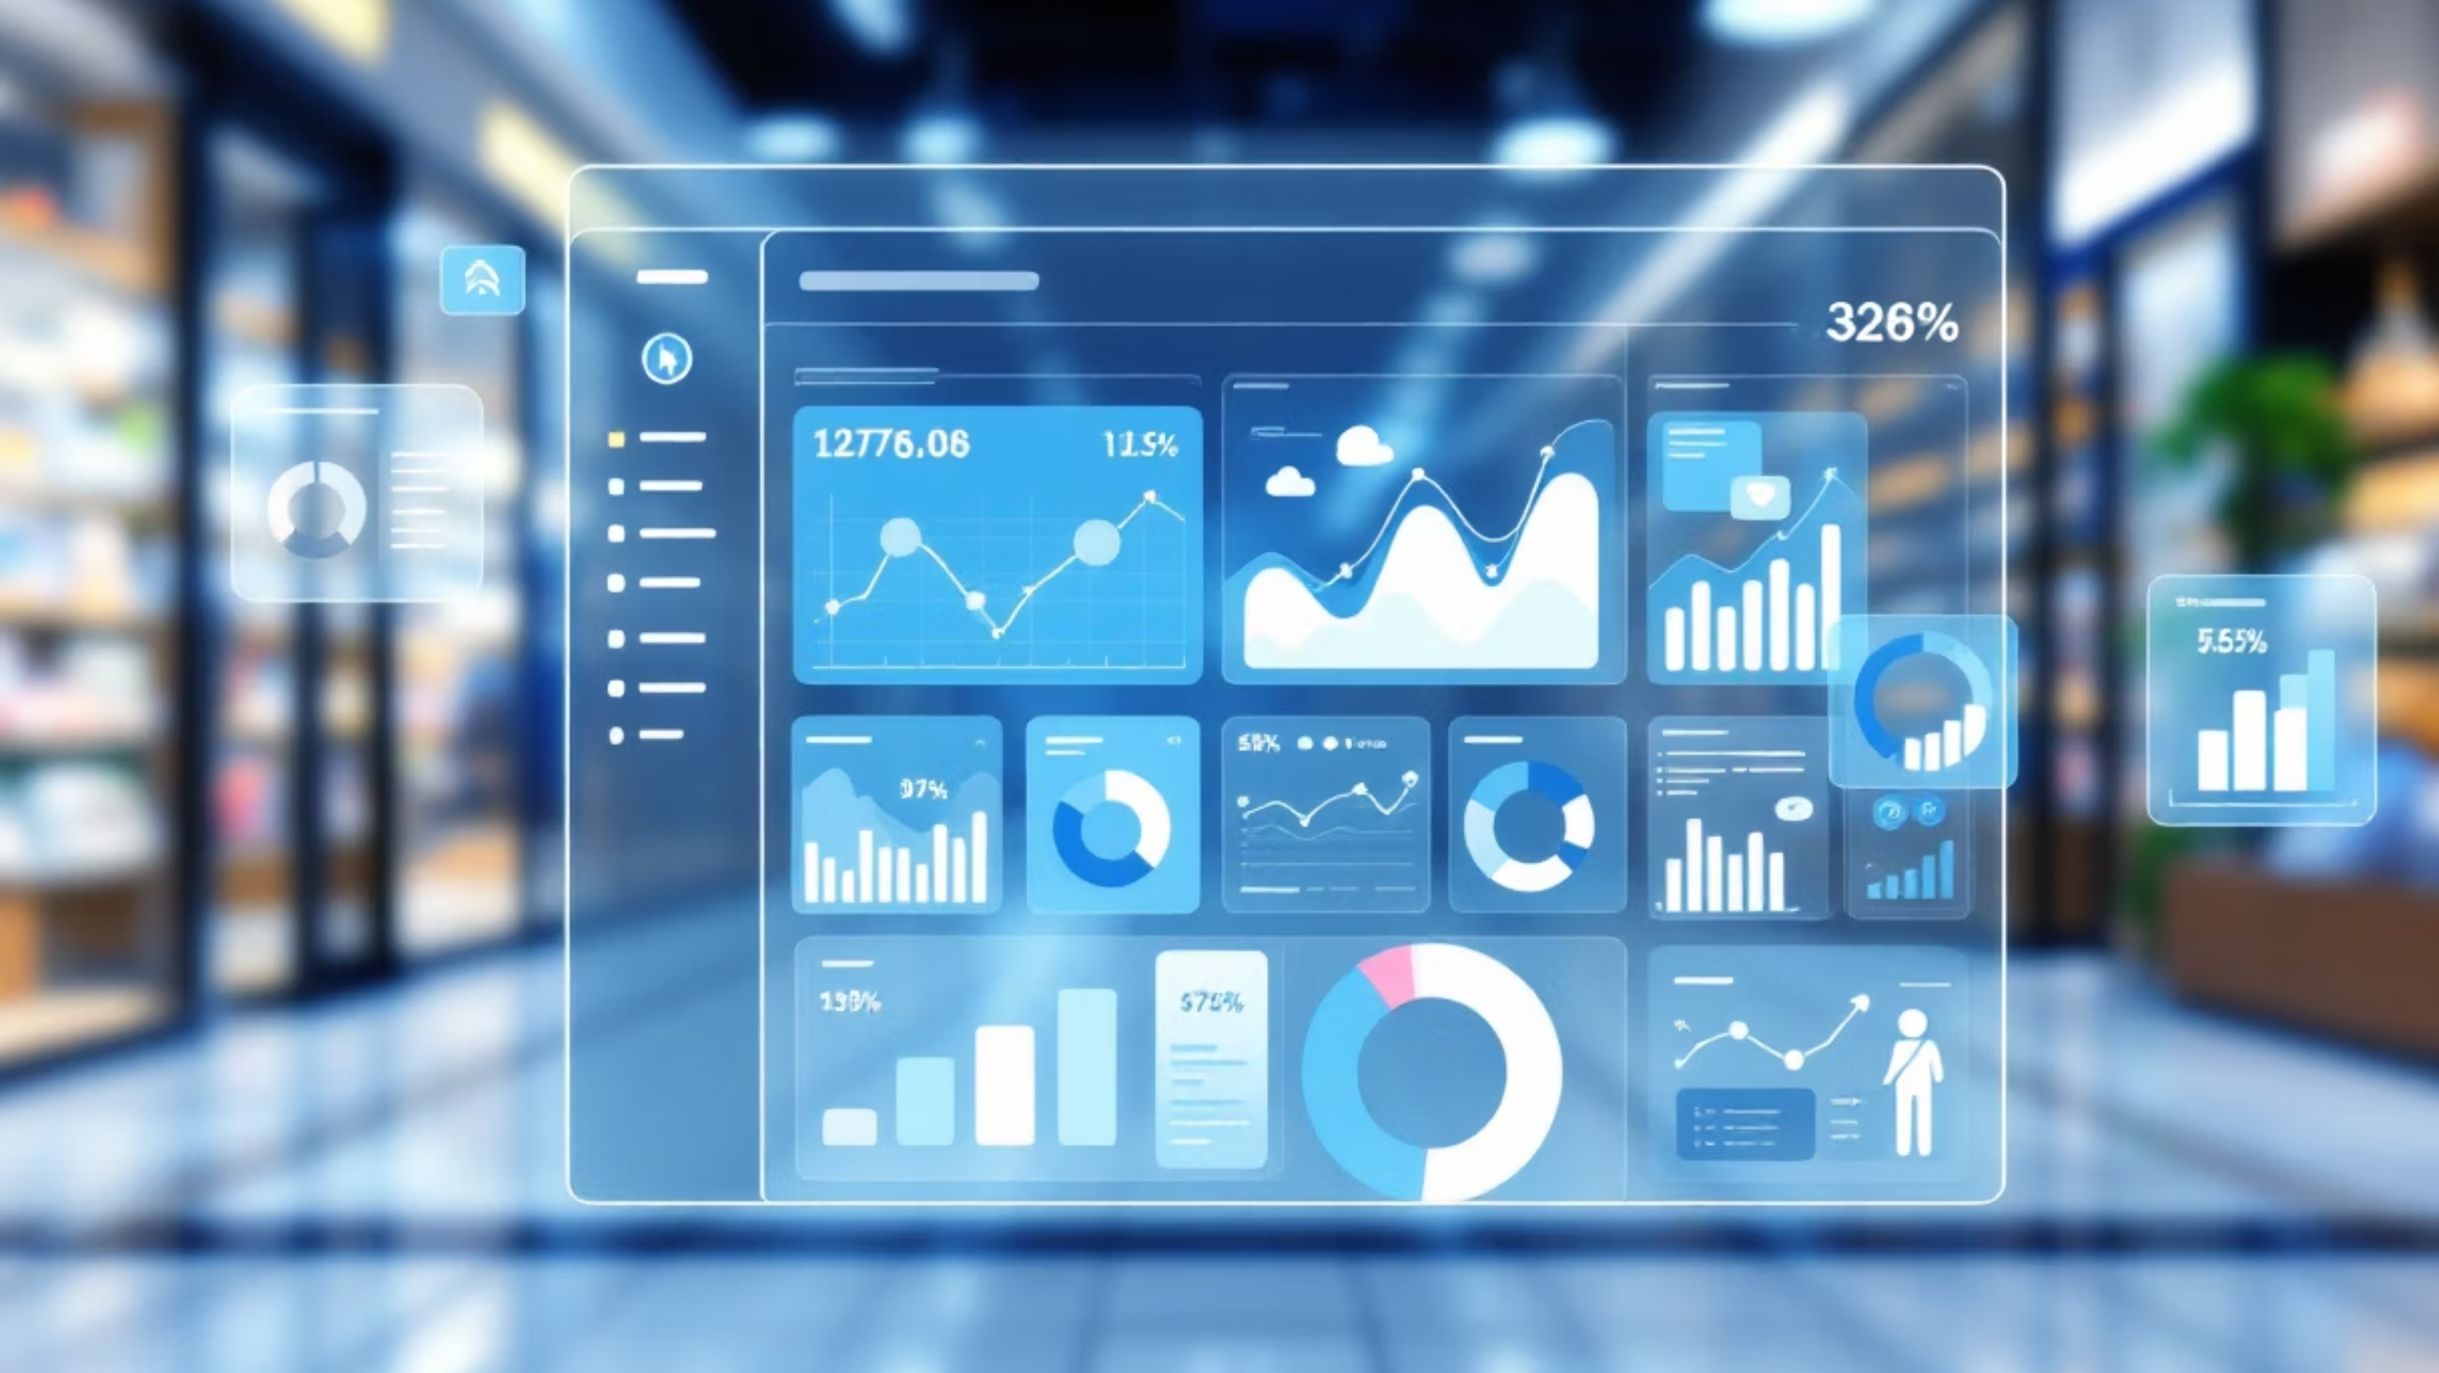




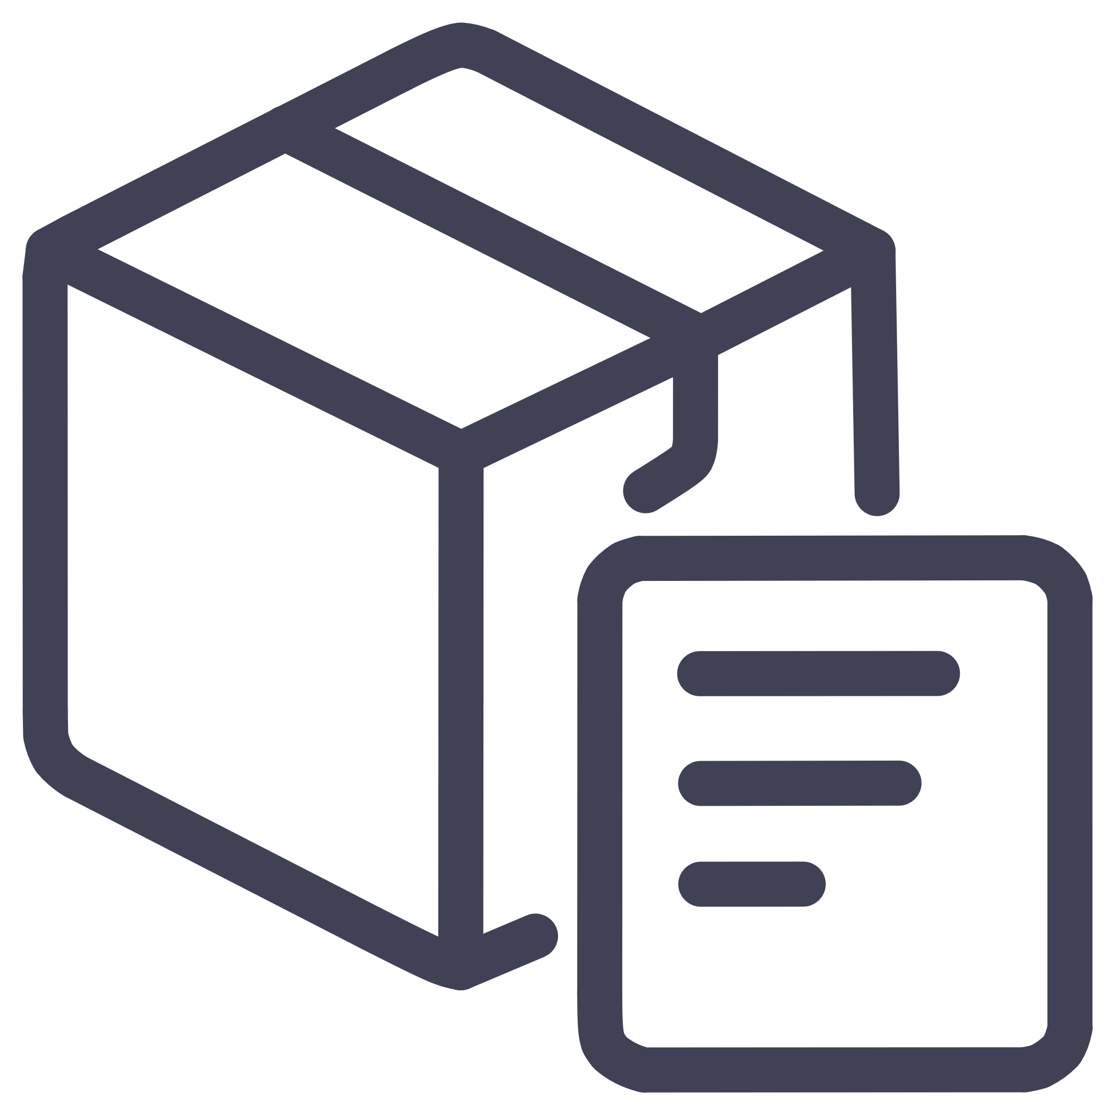
Six Use Cases Driving Business Value
Data Quality Control
Automated validation filtering erroneous transactions to ensure 100% financial reporting accuracy and regulatory compliance.
Promotion Analysis
Category-level sales lift measurement identifying high-ROI marketing strategies and campaign effectiveness.
Loyalty Point Engine
Accurate reward point calculations that increase customer lifetime value and drive repeat purchases.
Customer Segmentation
RFM-based identification of high-value and at-risk customer groups enabling personalized retention strategies.
Customer Notifications
Automated email communications closing the engagement loop by sharing earned value with customers.
Inventory Correlation
Lost sales estimation optimizing supply chain decisions and preventing stockout-related revenue leakage.

Slide 4
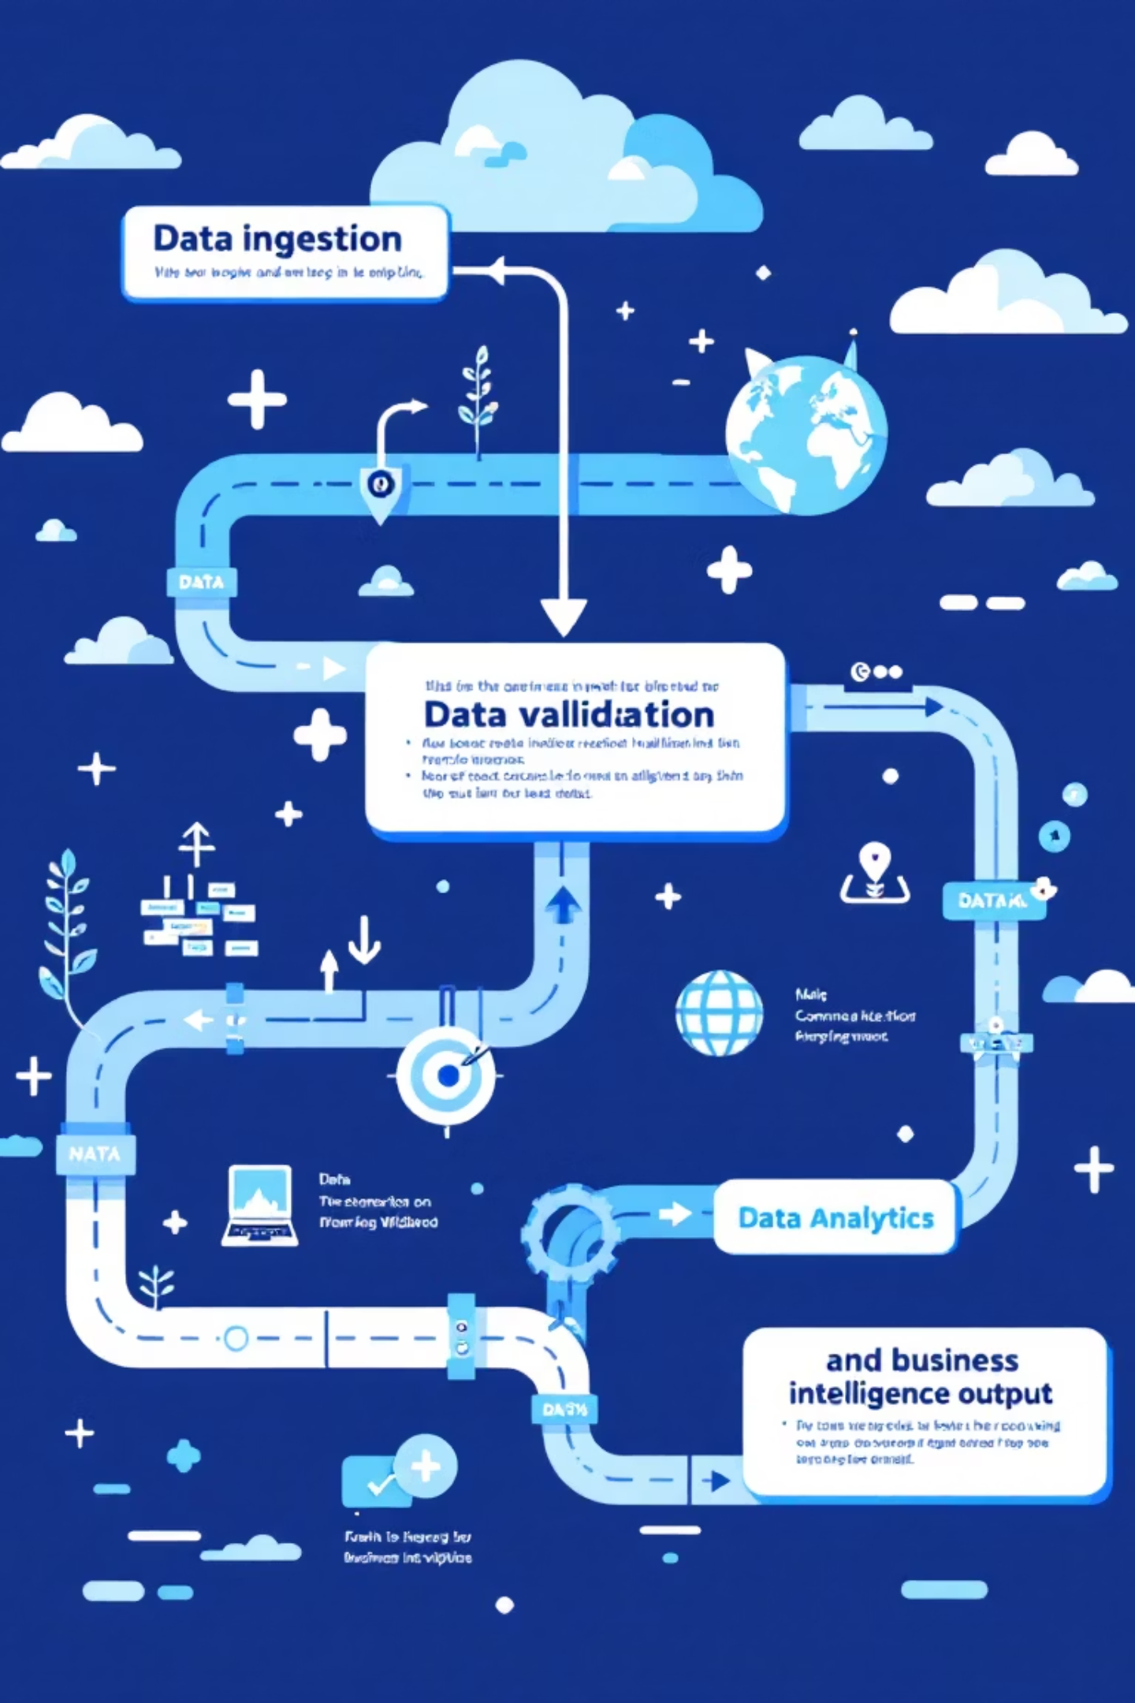




Technical Architecture Overview
Data Ingestion Layer
High-volume transaction data enters the system from multiple retail touchpoints and channels.
Quality Validation (data_gen.py)
Automated filtering segregates clean data from anomalies. Records with negative amounts or missing customer IDs route to Quarantine tables for audit.
Analytics Engine (analysis.py)
Implements loyalty calculations, RFM segmentation, and inventory correlation algorithms to generate actionable insights.
Business Intelligence Output
Clean, enriched data flows to dashboards, reports, and customer engagement systems for real-time decision-making.

Slide 5


Key Analytics Components
Loyalty Point Engine
Revenue Leakage Calculator
Standard Rule: Customers earn 1 point per dollar spent on every transaction.
Correlates top-selling products with store inventory to quantify lost sales opportunities from stockouts.
Bonus Incentive: Transactions exceeding $100 receive an additional 50-point reward to drive larger basket sizes.
Where average daily sales, days out-of-stock, and unit price determine potential revenue impact.

Slide 6
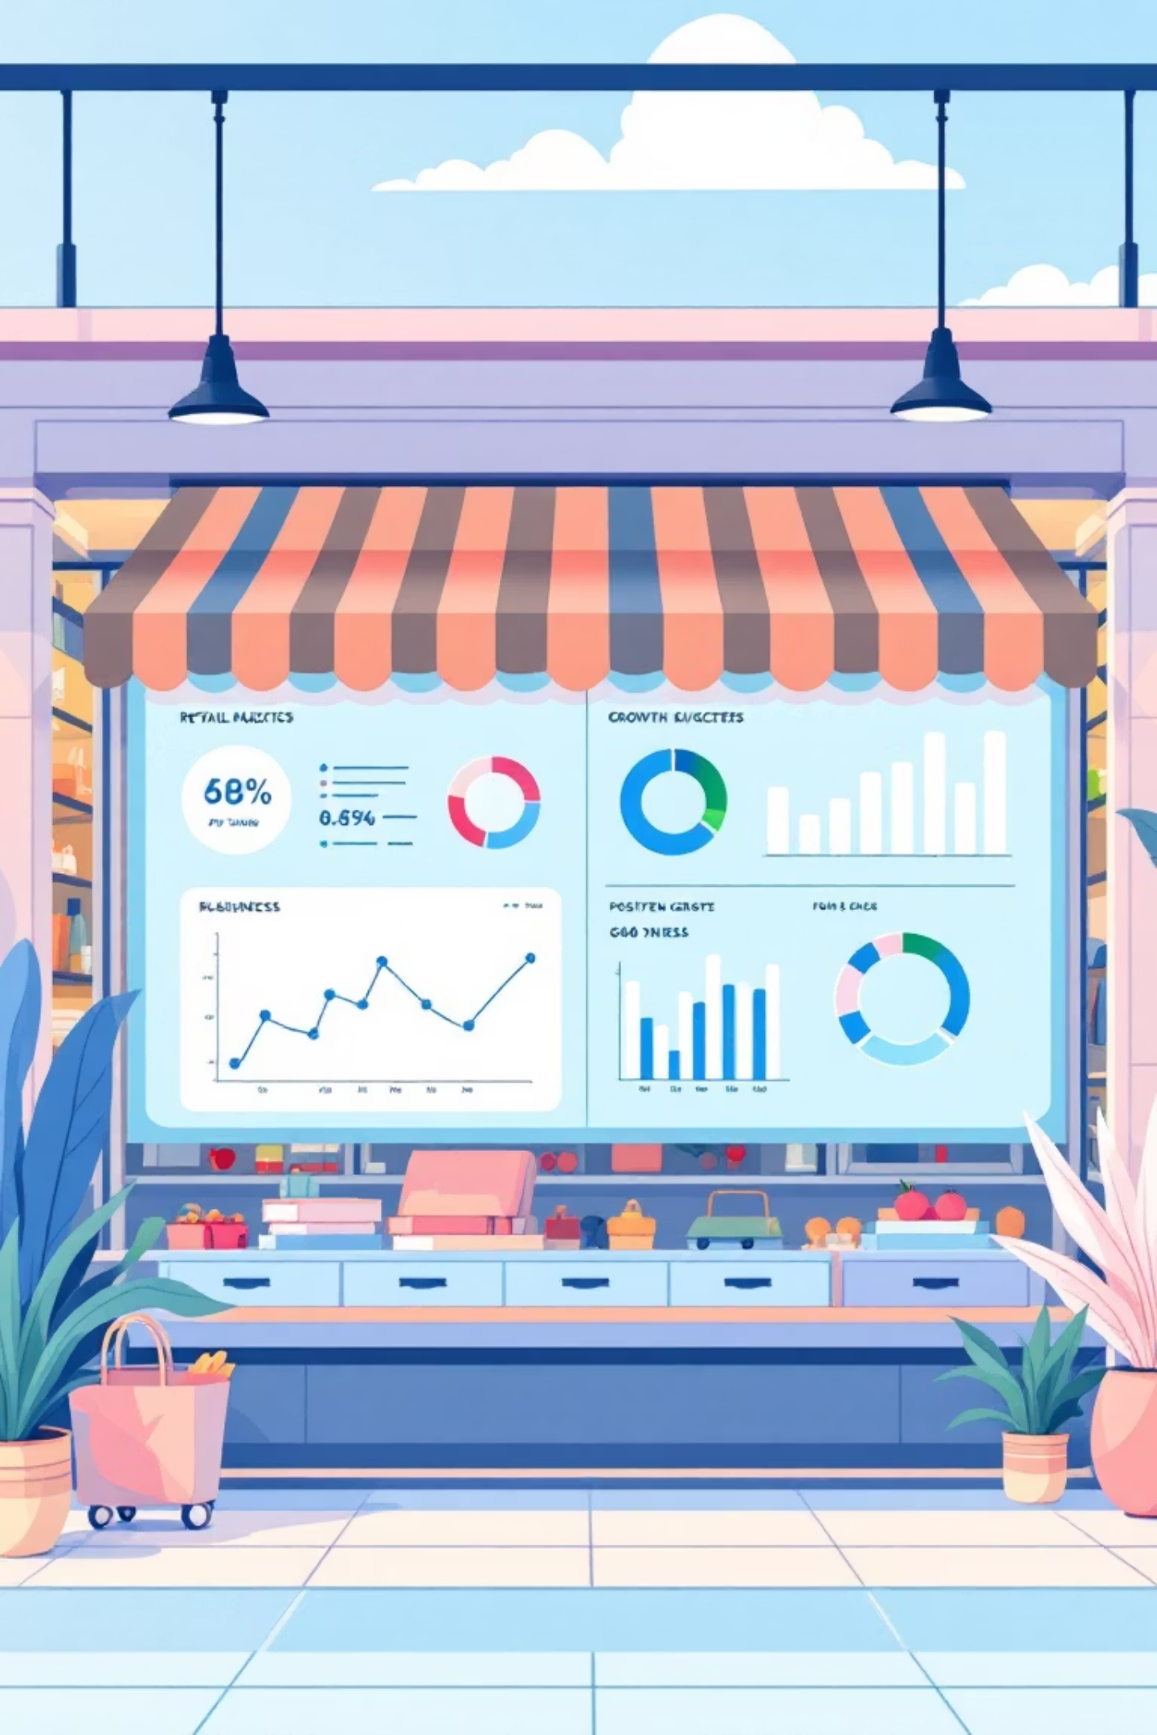



Business Impact & Results
Data Integrity Achieved
Customer Engagement
100% financial reporting accuracy through automated quality validation and quarantine workflows.
Closed-loop communications via automated email notifications sharing earned loyalty value.
Revenue Protection
Real-time inventory optimization preventing stockout losses and maximizing sales potential.
RetailInsight 360 successfully bridges raw data and strategic action, empowering stakeholders to protect revenue, reward loyalty, and optimize operations in real-time. The automated system eliminates manual processes while delivering sophisticated analytics that drive measurable business outcomes.

